Slide 1
Spring Object/XML mapping using Castor XML binding framework – Annotation Configuration
Using the Spring’s Object/XML Mapping, we can convert Object to XML or vice verse
XML Marshalling – Convert Object to XML.
XML UnMarshalling – Convert XML to Object.

Slide 2
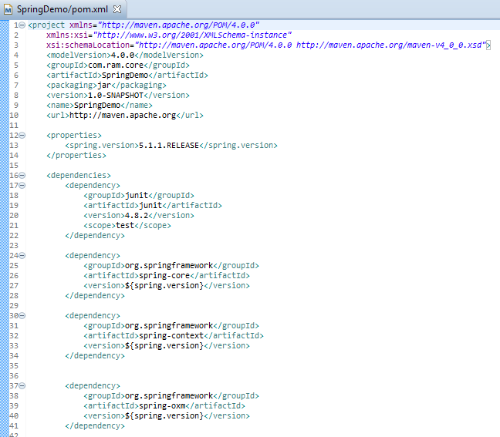
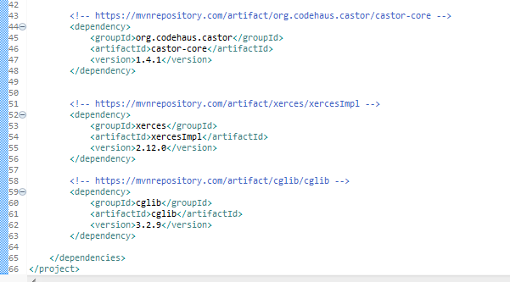
Spring Object/XML mapping using Castor XML binding framework – Annotation Configuration
Spring’s oxm itself doesn’t handle the XML marshalling or UnMarshalling, it depends developer to inject their prefer XML binding framework. In this case, we are using Castor binding framework.

Slide 3
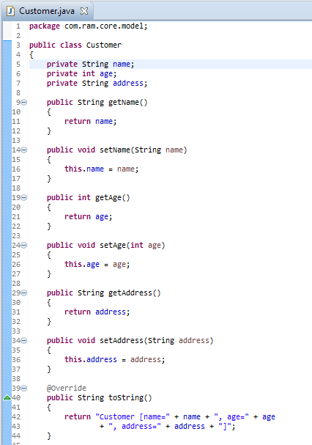
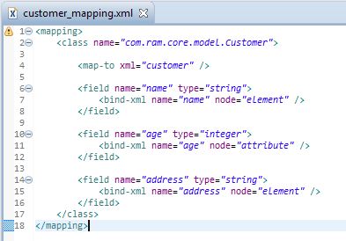
Spring Object/XML mapping using Castor XML binding framework – Annotation Configuration
We can use Castor XML mapping to define the relationship between Object and XML.

Slide 4
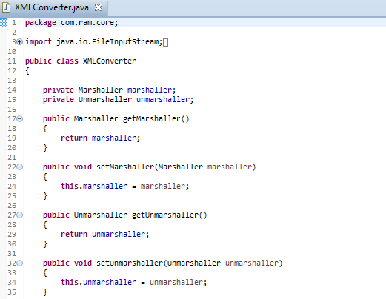
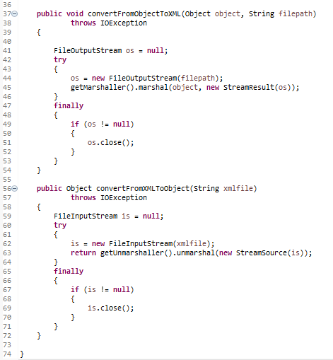
Spring Object/XML mapping using Castor XML binding framework – Annotation Configuration

Slide 5
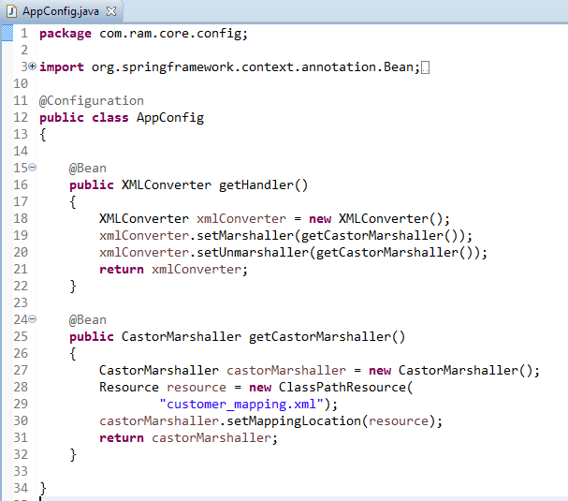
Spring Object/XML mapping using Castor XML binding framework – Annotation Configuration

Slide 6
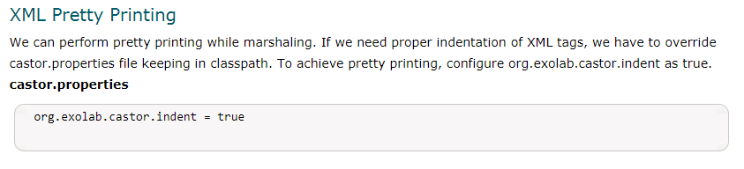
Spring Object/XML mapping using Castor XML binding framework – Annotation Configuration

Slide 7
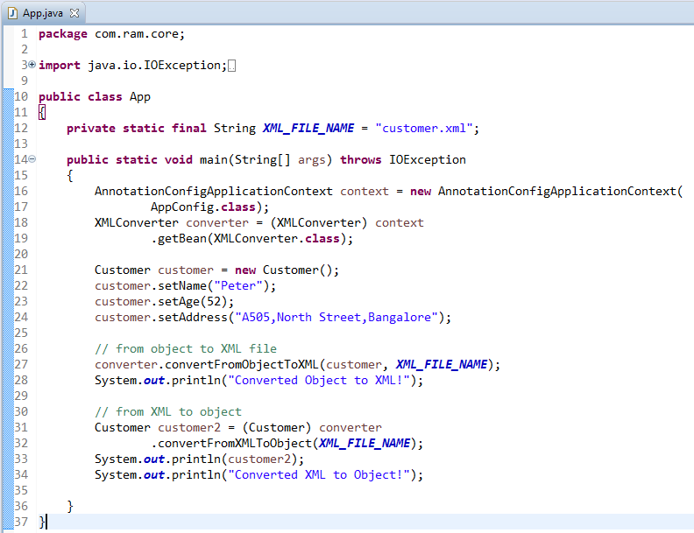
Spring Object/XML mapping using Castor XML binding framework – Annotation Configuration

Slide 8
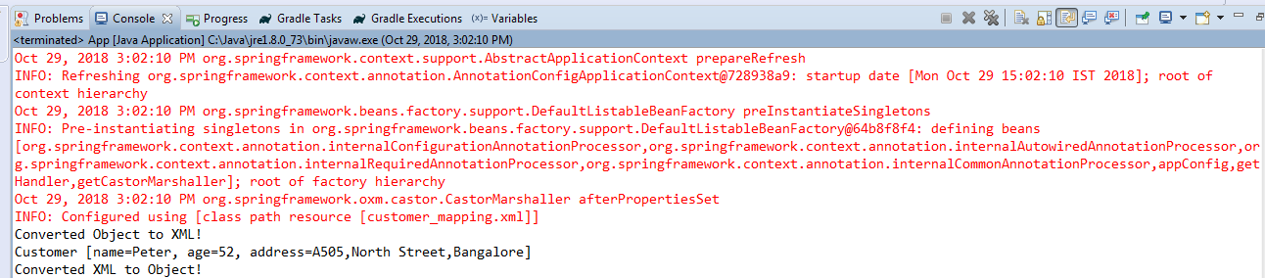
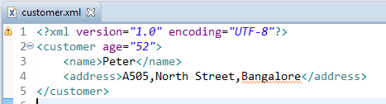
Spring Object/XML mapping using Castor XML binding framework – Annotation Configuration
“customer.xml” is generated in your project root folder

